Slide 1
Butt 1993
Hindi-Urdu Infinitives as NPs
061212 –na/ne, -na/ni/ne

Slide 2
Goals of Butt 1993, my comments.
Butt aims to show that –na has the external distribution of NPs
  She didn’t show any –ni in nominative position
  Without this it can be claimed that there are two na, one is na/ne, has inherent gender and it’s a pure gerund/noun, the other is na/ni/ne and gets its gender from the things it modifies, it’s a participle/adjective
  To provide this, make a list of the properties of the N/V internal alternations she found. Test both types in the object position of verbs that don’t assign –ko. Try I hit him on the ears with my loud screaming/curse/bell ringing?
  With this crucial data it is still possible to claim they are both NPs on the outside, with differing insides. And thus allows the matrix verb in LDA to agree locally with the –na rather than with the distant embedded object.
  Show both insides in the LDA and the non-LDA environmnets (ie the obliques) the complementary distribution of LDA and non-LDA=oblique argues that they are both the complements of the matrix verb. Esp since all the LDA matrix verbs I know are LEXICAL restructuring verbs… if they are funcitonal then need to explain them the way that other aux are explained. Either by percolating/concord or by a series of complement relationships..
Because of the lack of this crucial data she succeeded only in showing that SOME –na have the external distribution of NPs. And that there are two na with different internal structures, (similar to English –ing.)

Slide 3
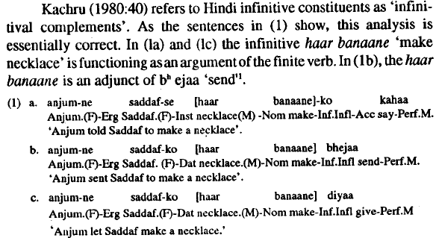
Constructions: “tell”, purposive,permissive –na, non-nominative objects= oblique ne.
Informant check: does bhejaa (always) mark its object
Anjum sent sadaf the letter
Change haar (M) to anguti (F) as these could easily be the masc from haar, rather than the default

Slide 4
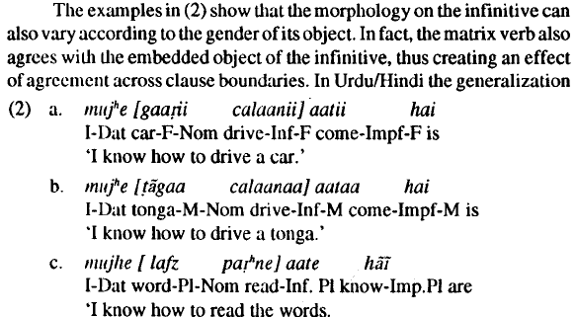
Nominative =agreement, Informant check: aatii never case markes its object

Slide 5
The difference between the two Butt 1993:53
At first glance, this -ne would appear to be same -ne as on the banaane 'make' in the "tell" construction, the purposive, and the permissive in (la), (1 b) and ( 1c) respectively, However, although the two form are homophonous, they do not perform the sane function. The -ne in the permissive is not a marker of agreement rather, it is a reflection of the non-nominative status of the infinitive. As (3) and (4) show, the -ne on banaane is invariable: it does not vary in order to agree with the nominative argument in the sentence. In (3b) a feminine infinitive to correspond to tlie feminine cur is ungrammatical Similarly, in (4b). a masculine infinitive to go along with the masculine tonga is bad.5
Will refer to the –na/ne as the infinitive.
infinitives can appear wherever NPs usually can: in subject, object, indirect object, or adjunct position(Butt 1993:61)
All the rest seems to be about the na/ne morpheme, not the na/ni/ne morpheme. Except valaa and LDA which goes with the na/ni/ne

Slide 6
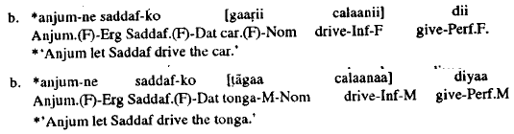
The –na/ne in the (1) cant agree, shown in 3b and 4b (these are bad examples because even if it were agreeing dii assigns an oblique case so it would be –e anyway)

Slide 7
My questions..
So if they were two morphemes the infinitive would be the default –na in the nominative contexts (not -nii), and –ne in the oblique contexts.

Slide 8
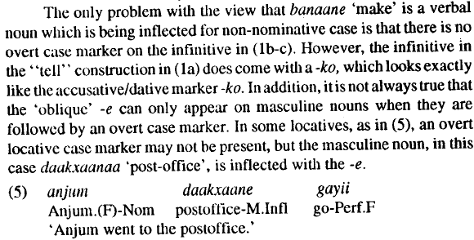
Where is the oblique coming from in (1b) (1c), some locatives don’t have anything either (this will help with my nouny-postpositions which end in –e)

Slide 9
Butt 1993:54
“To sum up, then, the morphology of the inflected infinitive banaane 'make' in the complex predicates discussed here suggests that banaane is functioning as a verbal noun and that the morpheme -naa/nii/ne is acting as a nominalizer.”

Slide 10
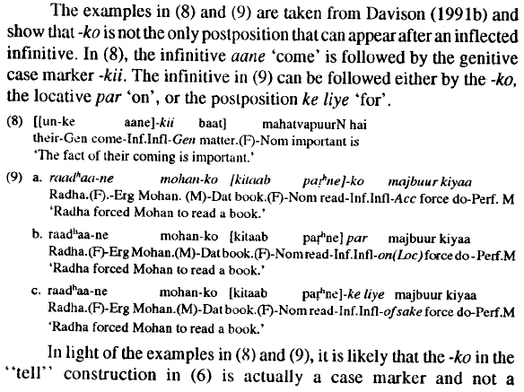
Point 1: non-finites can be case marked
The –ko in ``tell” isnt a complementizer,
Test 1: postpositions can appear with –ne too

Slide 12

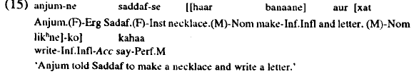
Test 2: conjoined NPs-ko, conjoined naPs -ko

Slide 13
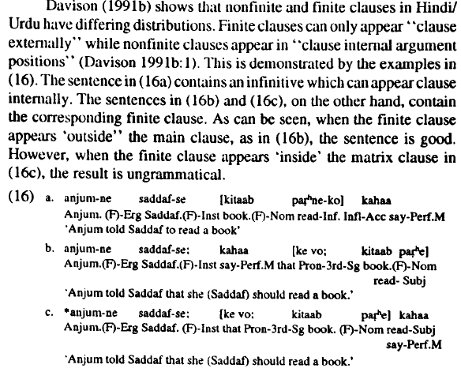
Point 2: Nonfinite clauses have to be governed and have case
``According to Davidson, nonfinite clauses can only appear in positions which are governed and are assigned case.” (Butt 1993:57)
``As Bresnan (1991) also presents evidence from Bantu against the Case Resistance Principle, and as it is not quite clear how the 'semantic' case of infinitive adjuncts marked by postpositions interacts with abstract Case, the idea that infinitive constituents are simply NPs and as such have all the case-taking properties associated with NPs seems preferable.” (Butt 1993:58)

Slide 14

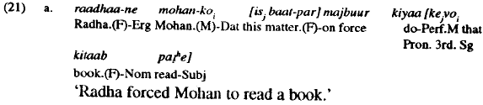
Point 3: nonfintes arent CPs:
Test 1: coindexed demonstratives are needed in Correlatives, and in finite CPs,
CPs cant be in a case position so, they are post-verbal.
Srivastav says there are two types of correlatives. The one Butt uses is “a quantificational structure in which the relative clause binds the main clause nominal.” Srivastav (1992:653), “only NPs with demonstratives qualify as variables that can be bound in such configurations.” Srivastav (1992:655)
‘’the finite "that" clauses … seem to pattern with the correlative construction in (18). That is, they behave as if they are subordinate clauses which must coindex with a demonstrative in the main clause. The pattern is illustrated in (21), taken from Davison (1991b:3).’’(Butt 1993:59) ``demonstrative is 'this' is available for coindexing with the finite "that" clause. But if there is no demonstrative in the main clause, as in (21 b), the resulting sentence is bad.”

Slide 15
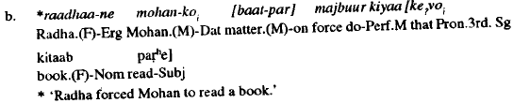
Finite CPs need the demonstrative
The main clause needs a demonstrative, which is coindexed with the complementizer…
Check with informants: try other sentences to show this is the case, it just sounds like its missing something here..
Butt says that infinitives don’t act like correlatives so they arent CPs, but she doesn’t give any proof. Check with informants,

Slide 16
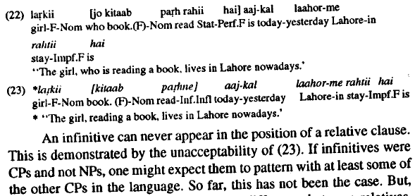
Test 2: non-finites cant go where restrictive relative clauses go
Restrictive relative clauses are analyzed as CPs which modify a noun by Srivastav (1991:638).

Slide 17
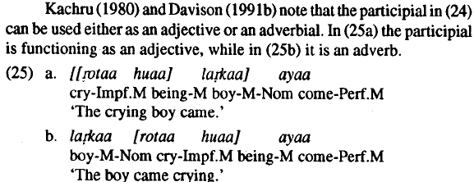

Point 4: its not finiteness that makes them impossible where CPs are,
Test 1: they cant go where other non-finites go (participial construction)
The ``participial construction” by Kachru 1980:34
Defined by having an agreeing honaa
Can be used as an adjective or adverbial
No morphology that suggests these are the verbal nouns they are formed with the root+t+gender +ho+gender the imperfect and copula (in the perfect form? Or is the bare ya/a ending a finite?)

Slide 18
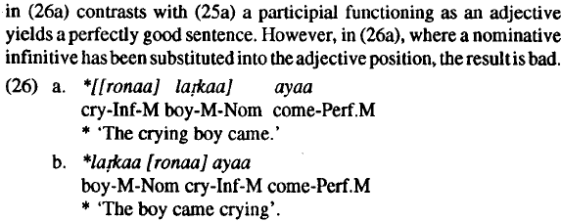
distinctions must also be drawn within the category of nonfinite clauses. Infinitives have the distribution of NPs while the participials in (25) pattern with adjectives and adverbials.
Infinitives cant appear where participials can. But this example doesn’t make sense as –na the aspect or something is wrong…try a more semantically felcitous root and noun?

Slide 19
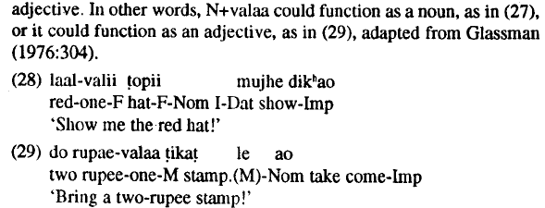
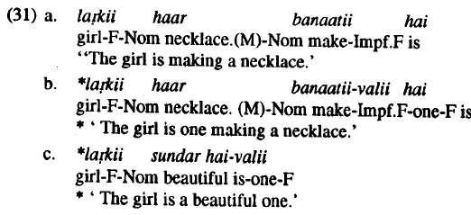
Test 2: valaa can attach to infinitives but not to verbs
Glassman (1976: 304) characterizes-valaa 'one' as a suffix (which) may imply the possessor, seller, agent, or distributor of something, have the sense of 'the one with' or be used to convey value or price. It inflects to agree with whatever it is used with.'' T. Mohanan (1992) identifies two types of -valaa, one which attaches lexically, as in (27). and one which attaches to a phrase.
Lexically to either noun or adjective, no change in category
Valaa can attach to infinitives but not to verbs(31b)
Butt doesn’t show an example of it attaching to an infinitive, because infinitives are phrasal.
Check: Yeh larki haar banaatii-valii thi, aur vo larki, anguti.

Slide 20
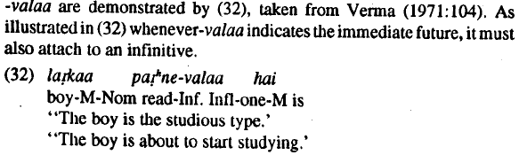
Valaa attaches to infinitives
Valaa which attaches to phrases can be used as “immediate future” and “adjectivization transformation” (Verma 1971:104)
both must attach to the infinitive, both uses are shown in (32)

Slide 21
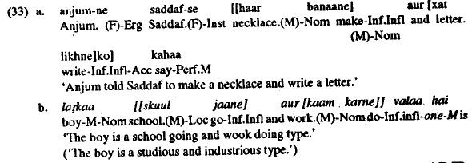
Its attaching the the phrase, not to the infinitive (cordination test)
Lexical categories cant be conjoined (T. Mohanan 1992:10) (does this mean roots in my framework?)
Since infinitives can be conjoined and have valaa outside, just as with -ko, they must be phrasal.
The valaa phrase can be an NP or a AdjP
If the two valaas are paralle N+valaa=N, inf+valaa=NP then the inf must be an NP

Slide 22
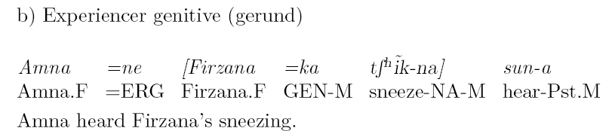
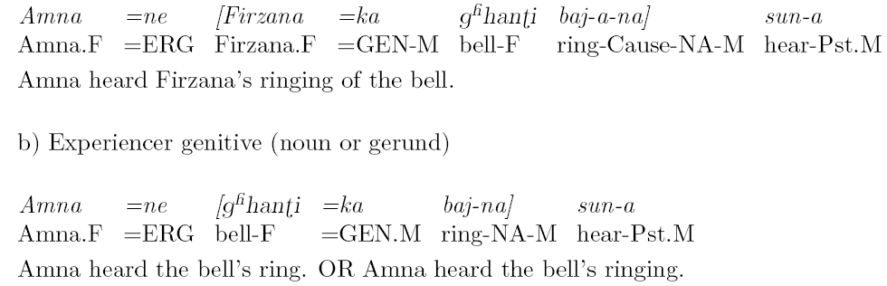
Checking the gender of the gerund/infinitive that Butt is looking at, it seems to be the na/ne not na/ni/ne
check with informants non-inf NPs, like bell ring, and with a gerund
The –na that Butt is looking at seemst o be the gerund, can I get the gerund to show the –ii form? Farzana’s ganti bajani sub se atcha hai..
1b shows sneeze in the default, can it agree? Try both a female noun cikhi and gerund
2 shows ring in default, can it agree?
2a shows cause (v) morpheme under a gerund/infinitive
Even if the gerund/infinitive cant agree, (or maybe it just has an expletive/PRO subject?), and the na in LDA can then the na in LDA is a participle, therefore an adjective so it can still bear gender features. I just have to show that the restructuring verb can agree with adjectives. Try something with valii, and something with a pure adjective phrase.. Maybe valii is only an adjective too? Since it agrees…
It could still be a noun, as the masculien pardigmn might be the most popular. What gender is the noun of a verb in frehcn ?
Julie says that hindi has high nominlizations (ie inclues v) legate to appear p17

Slide 23
-na/ne is verby too
Scrambling and adverbs

Slide 24
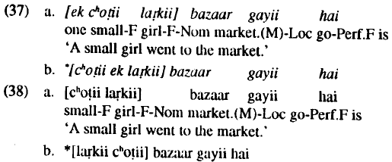

Test 1: No scrambling in NPs but yes in infinitives
Check with informants, a more nouny NP with a complement and PP can it scramble? Butt checked with a descriptive adjective, not a noun’s complement.

Slide 25
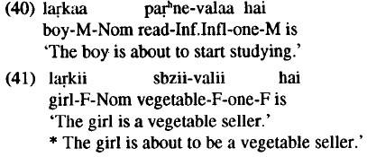
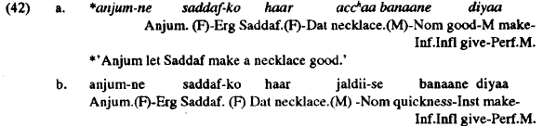
Test 2: eventive, NPs can have aspect, INF cant have adjectives
Simple nouns can never have a aspectual properties with valaa. (try one that is semantically a better fit…)
Infinitives cant have adjectives, try a root with stative semantics to get a better fit?
Check with eventy nouns for jaldi-se

Slide 26
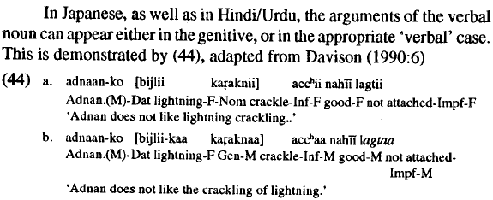
Test 3: arguments in the genitive, or in cases the verb would assign
The –na can either assign genitive to its arguments or it can assign nominative (and dative too I think, try with informants to get –ko)
In 44 crackling can take lightning as its subject and assign genitive, then there is default agreement. It also can take lightning as null.
What is the difference? (could be that lighting doesn’t raise ot spec n in one, in the other it raises)
Is this the ACC-ing and GEN-ing of english??

Slide 27
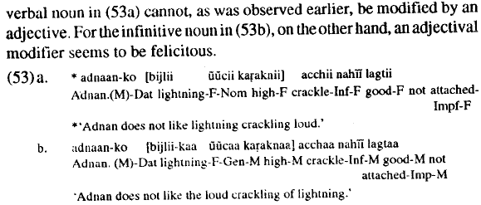
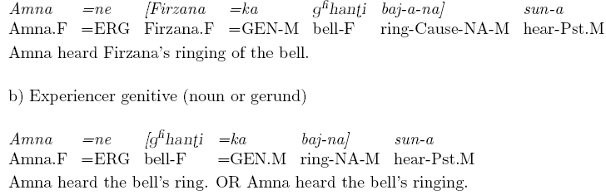
There are two internal structures of -na
The verbal noun (with no genitive and with agreement) cant have an adjective.
The noun (with genitive and no agreement) can have an adjective
can have genitive on both the agent and the theme (but not in the same clause)

Slide 28
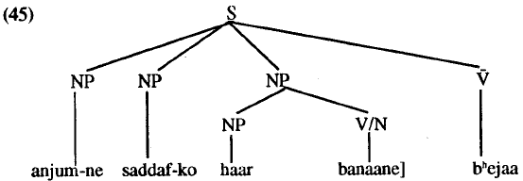
So, its an NP on the outside, and a N or V on the inside
Butt says the solution must be something like what Manning 1992 proposes: verbal nouns are underspecified, only specified that they need to be the sister of the verb.
Her structure

Slide 29
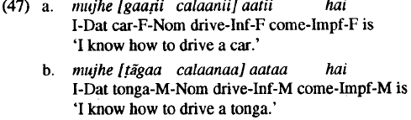
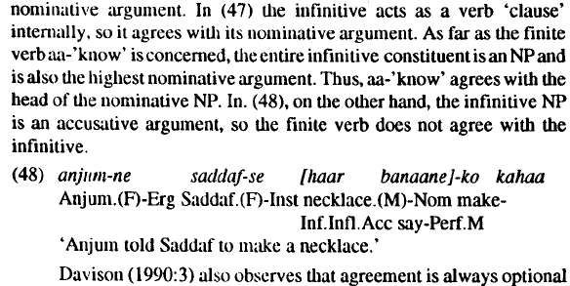
If –na/ne is an infinitive is externally an NP then LDA is explained
Davison (1988,1990,1991a,1991b) examples of LDA with ``aataa” which is optional.
Butt says this might be similar to the nominal gen vs verbal acc case above.

Slide 30
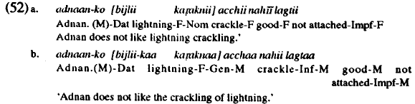
Its optional because of whatever reason is of the N/V alternation in internal structure
When gaari is really an argument, there is no genitive and there is agreement.
When the na is a noun there is genitive and, there is no agreement. And there can be an adjective
``suggest that the infinitive here is behaving like a 'real' noun rather than as a verbal noun. Since the kapknaa 'crackling' in (52b) does not have any verbal properties, its arguments must show up in the genitive.” Butt (1993:69)

Slide 31
Do these N/V structures correspond to gerund/participle?
Can you have the one with an adjective in an LDA? If yes, then the –na in LDA can be the same as Butt’s nominalizer/verbalnoun/infinitive. If no then it might be the participle
In the pure noun context if –na is only masucline that’s because it IS the head so it cant get its agreement from somewhere.
In the v context it can be a verb/participle cause it takes its agreement.
So it can be one head, if you adopt lexical underspecification. Put different functional heads around it (on top or bottom…) to get the effect of N or adjective..
In the restructuring analysis is the structure on top of na that makes the difference for whether na is an N or a V

Slide 32
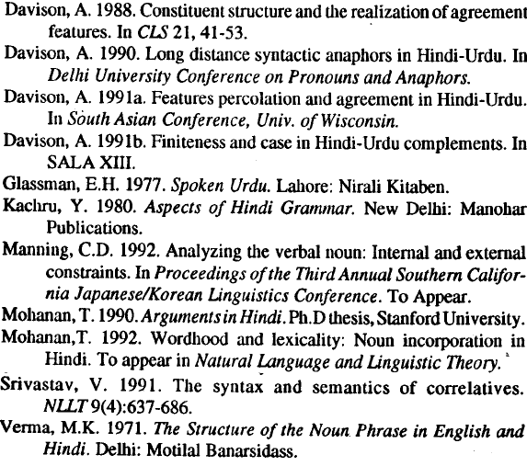
Butt’s references to look up

